Slide 1

Security Center
Ibraheem, David, Jeremy, Cam
Notes:
Jeremy

Slide 2
Motivation
The goal was to construct a security center capable of providing visual monitoring of a specific area.
Existing commercial security cameras are limited, with no automated tracking.
The Security Center incorporates multiple sensors and a control system to provide direction to the camera system, thus making it a smart system sensitive to both motion and sound while also providing the operator with wireless management, monitoring, and controls.
Notes:
jeremy

Slide 3
Overview
A Security Center for the home that users can view and control as easily watching a TV show
The security center features:
An alarm system
A wireless control system via a handheld Command Unit
Automated and Manual Operations
Automatic video panning to follow motion using multiple integrated motion and sound sensors.
Manual panning through user control
Notes:
jeremy

Slide 4
Block Diagram
Notes:
jeremy

Slide 5
Unit Functions
Command Unit
Processes incoming data from Control Unit
Transmit commands (Left/Right & Auto/Manual Mode) to Control Unit
Receives sensory data from Control Unit
Control Unit
Reports sensory data to Command Unit
Controls camera movement
Notes:
david

Slide 6
Hardware Description
(2) MSP430 Launchpad
(2) XBEE OEM RF Wireless Module
UART used for communication between the “Command” MSP430, and the “Controller” MSP430.
Use UART to establish a wireless link via 2.4GHz Zigbee modules.
Utilizing MSP Hardware UART dedicated pins and 3.3V serial communication
Notes:
david

Slide 7
Hardware Description (cont.)
(1) Servomechanism
Used to pan the camera
Either use buttons to control the servo or motion and sound sensors to direct the movements
MSP430 Interface GPIO – PWM Signal
(1) Parallax Sound Impact Sensor
Single bit output to indicate sound to the MCU
(3) PaPIRS: Passive Infrared Motion Sensor
Single bit output to indicate movement to the MCU
Provides 3 points of monitoring (left, center, right)
Notes:
hardware

Slide 8
Hardware Description (cont.)
(3) Push Buttons
Single bit output to indicate signal.
Auto/Manual controls
Pan left
Pan right
(1) LED
Single bit to light up alarm to report activity in monitored area.
Notes:
david

Slide 9
Software Description
IAR Embedded Workbench
Programming the MSP430 ultra-low-power microcontrollers.
MSP HW UART Registers for ZigBee Interface
CCP, Timer for generation of pulse width and frequency
Interrupts on button press and UART
Polling for all sensors
ASCII characters used for communication
Notes:
abe

Slide 10
Communications Protocol
Auto Operation
TX auto mode command
RX sensor data
TX camera motion commands
Manual Operation
TX camera motion commands
Control Unit
Command Unit
1
2
3
Control Unit
Command Unit
1
Notes:
abe

Slide 11
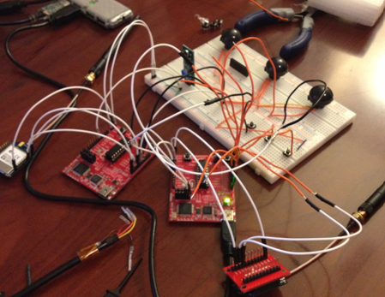
Prototype
Parallax
Sound Sensor
PaPIRS
IR Sensors
ZigBee Module
And Antenna
Push Buttons
ZigBee Antenna
Notes:
kam

Slide 12
Results
Implementation of the Security Center was a success.
Hardware integration into handheld controller and camera stand.
PCB to solder/integrate
All devices connectorized for easy assembly
Cylindrical housing for local control unit
Software integration to incorporate all devices
Polling
Interrupts
UART Pre-defined Registers
PWM using Timer-A
Notes:
kam

Slide 13
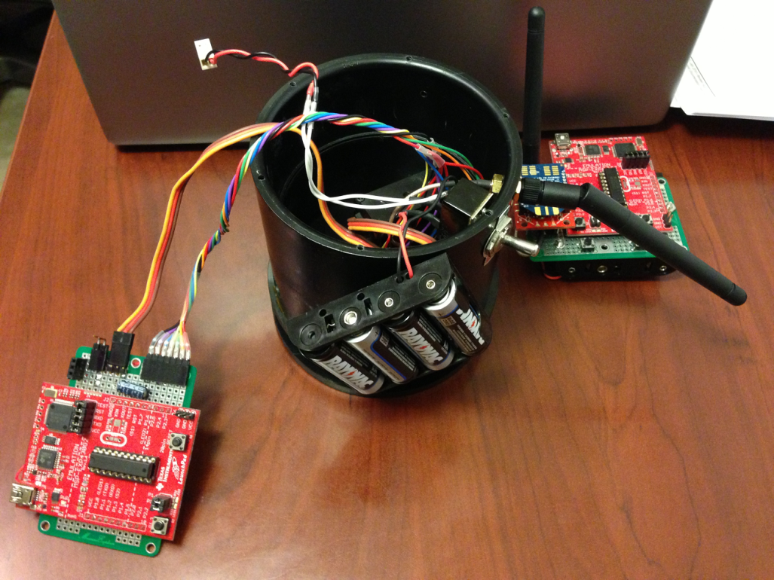
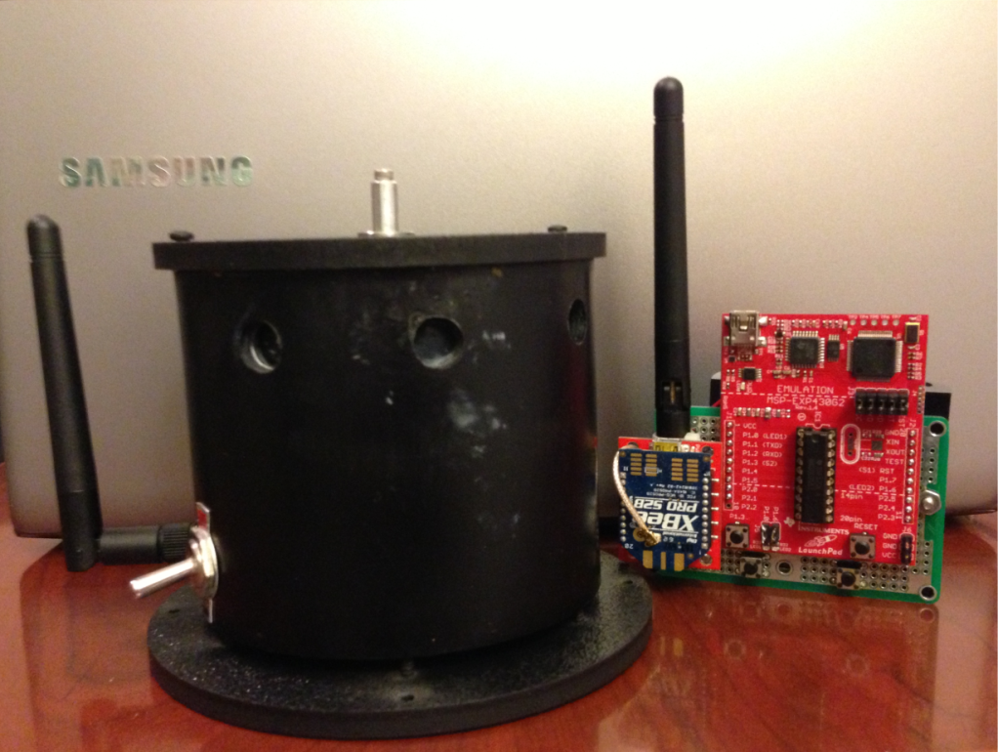
Demonstration
Notes:
abe

Slide 14
Questions?
Notes:
kam

